Slide 1

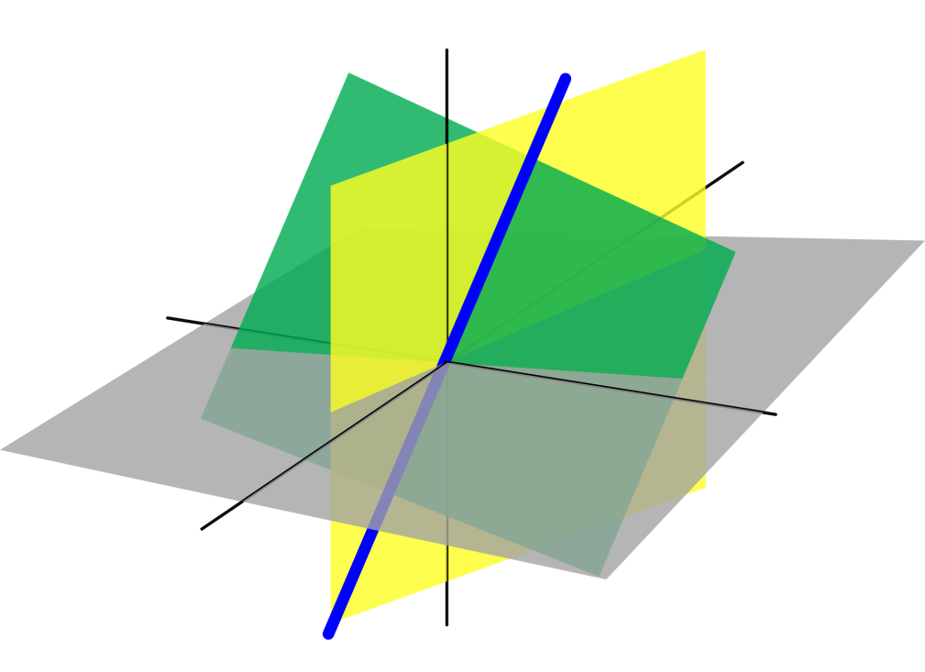
Azərbaycan Dövlət Neft və Sənaye Universiteti
Analytic Geometry

Slide 2
The Straight Line on a Plane

Slide 3
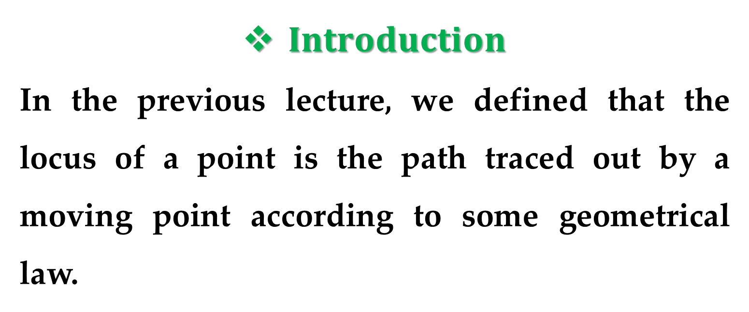
$Introduction$
In the previous lecture, we defined that the locus of a point is the path traced out by a moving point according to some geometrical law.
We know that the locus of a point which moves in such a way that its distance from two fixed point is equal represents a straight line.

Slide 4
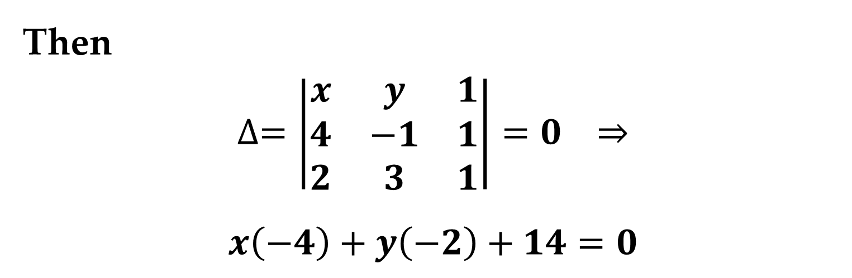
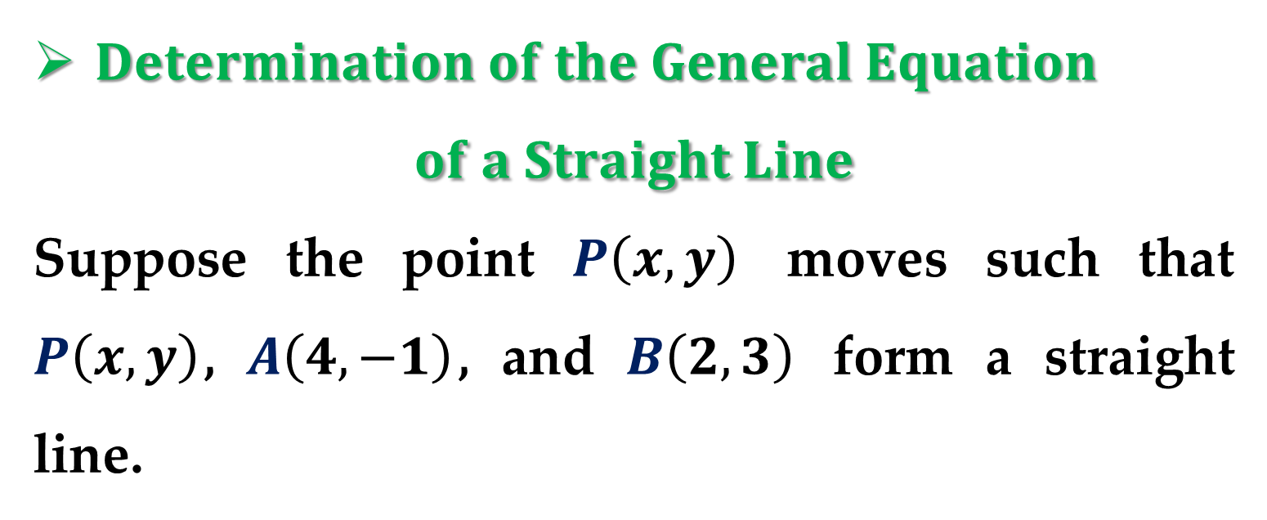
$Determination of the General Equation$
$$of a Straight Line$$
Suppose the point $P\left(x,y\right)$ moves such that $P\left(x, y\right)$, $A\left(4, −1\right)$, and $B\left(2, 3\right)$ form a straight line.
Then
$$∆=\left|\begin{matrix}x & y & 1 \\ 4 & −1 & 1 \\ 2 & 3 & 1\end{matrix}\right|=0 ⇒$$
$$x\left(−4\right)+y\left(−2\right)+14=0$$

Slide 5
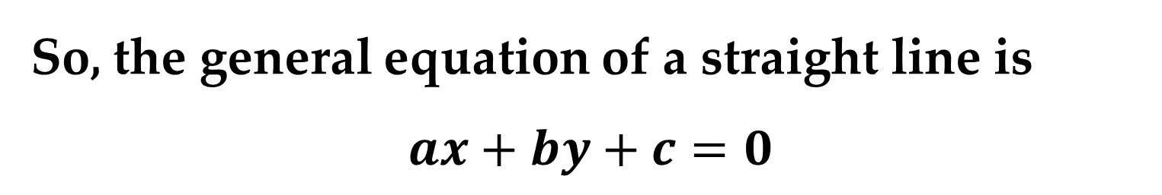
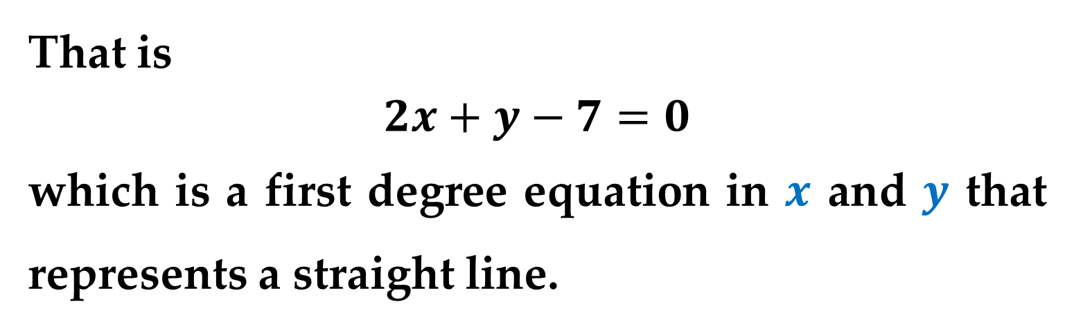
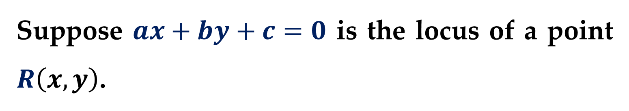
That is
$$2x+y−7=0$$
which is a first degree equation in $x$ and $y$ that represents a straight line.
So, the general equation of a straight line is
$$ax+by+c=0$$
Suppose $ax+by+c=0$ is the locus of a point $R\left(x, y\right)$.

Slide 6
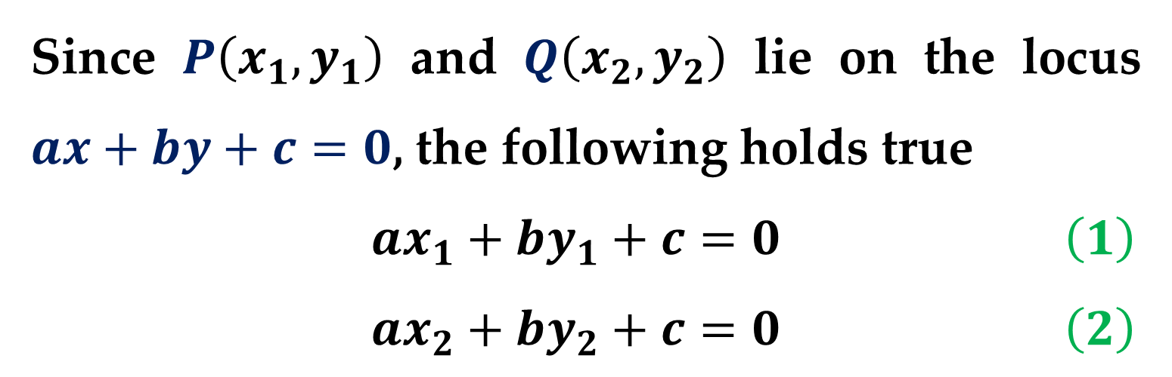
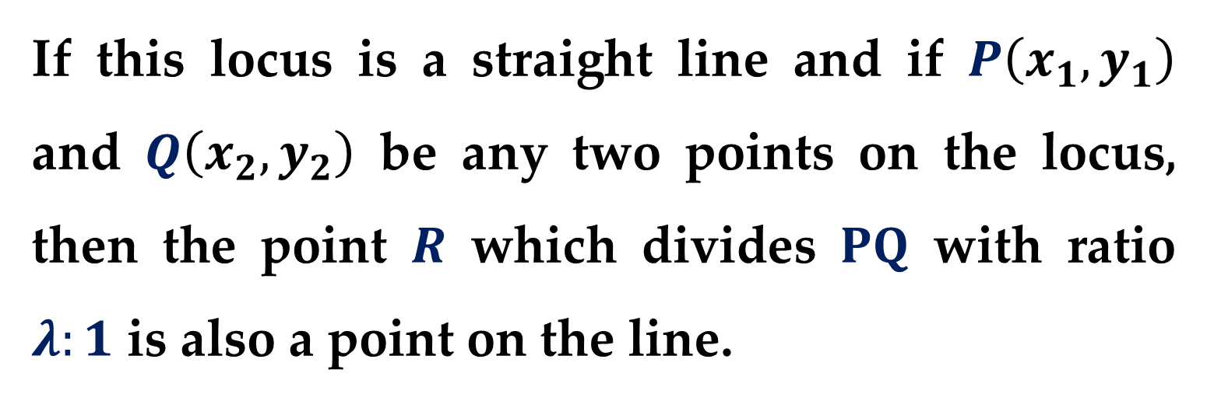
If this locus is a straight line and if $P\left(x_{1}, y_{1}\right)$ and $Q\left(x_{2}, y_{2}\right)$ be any two points on the locus, then the point $R$ which divides $PQ$ with ratio $λ:1$ is also a point on the line.
Since $P\left(x_{1}, y_{1}\right)$ and $Q\left(x_{2}, y_{2}\right)$ lie on the locus $ax+by+c=0$, the following holds true
$ax_{1}+by_{1}+c=0$ $\left(1\right)$
$ax_{2}+by_{2}+c=0$ $\left(2\right)$

Slide 7
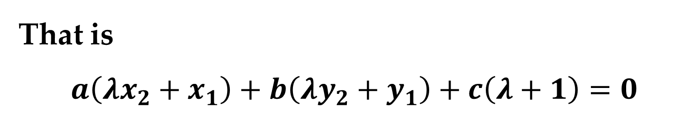
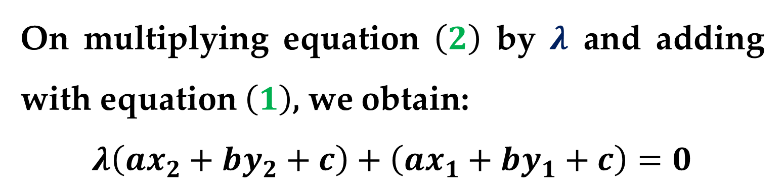
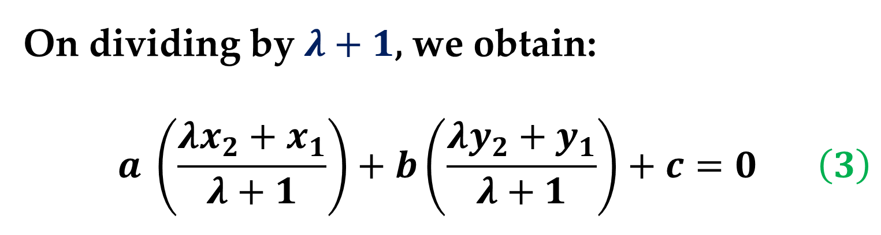
On multiplying equation $\left(2\right)$ by $λ$ and adding with equation $\left(1\right)$, we obtain:
$$λ\left(ax_{2}+by_{2}+c\right)+\left(ax_{1}+by_{1}+c\right)=0$$
That is
$$a\left(λx_{2}+x_{1}\right)+b\left(λy_{2}+y_{1}\right)+c\left(λ+1\right)=0$$
On dividing by $λ+1$, we obtain:
$$a \left(\frac{λx_{2}+x_{1}}{λ+1}\right)+b\left(\frac{λy_{2}+y_{1}}{λ+1}\right)+c=0 \left(3\right)$$

Slide 8
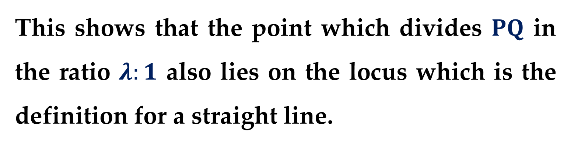
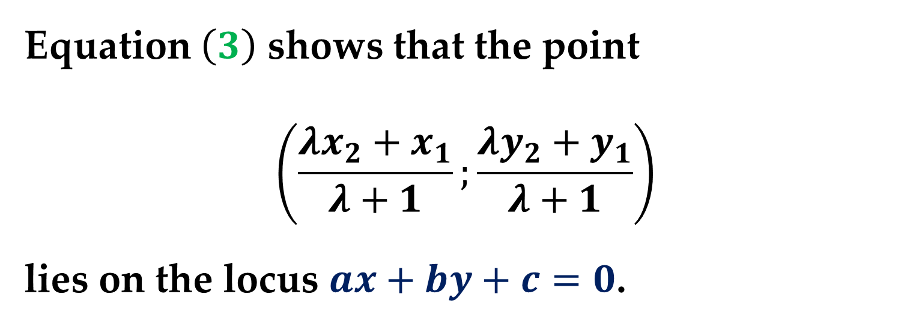
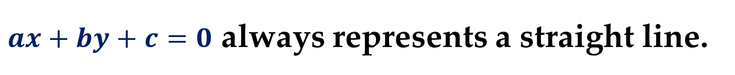
Equation $\left(3\right)$ shows that the point
$$\left(\frac{λx_{2}+x_{1}}{λ+1};\frac{λy_{2}+y_{1}}{λ+1}\right)$$
lies on the locus $ax+by+c=0$.
This shows that the point which divides $PQ$ in the ratio $λ:1$ also lies on the locus which is the definition for a straight line.
$ax+by+c=0$ always represents a straight line.

Slide 9
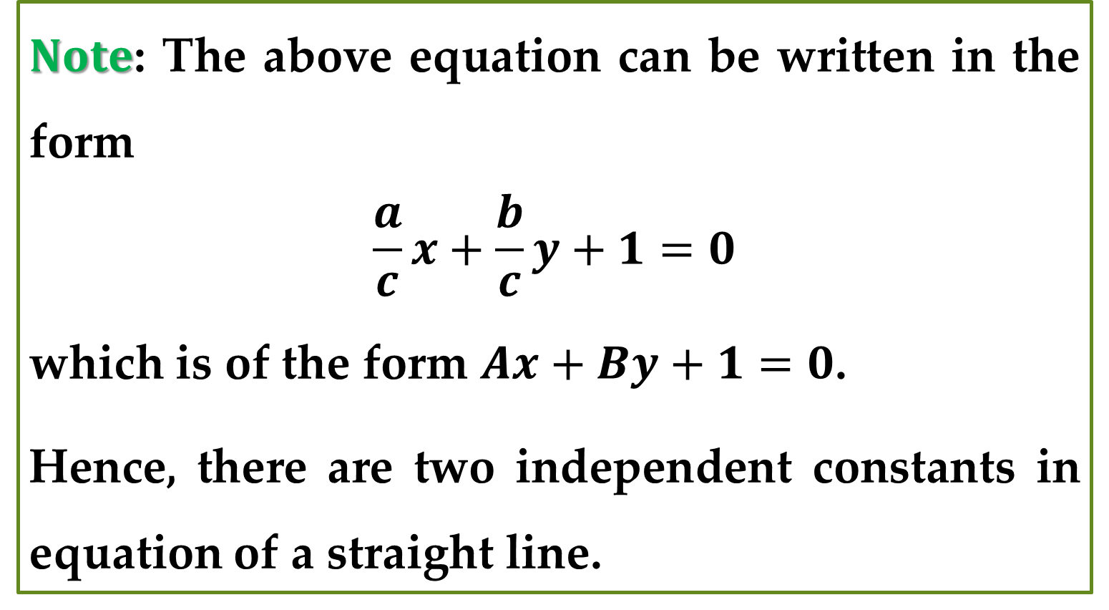
$Note$: The above equation can be written in the form
$$\frac{a}{c}x+\frac{b}{c}y+1=0$$
which is of the form $Ax+By+1=0$.
Hence, there are two independent constants in equation of a straight line.
Next, we look into various special forms of the equation of a straight line.

Slide 10
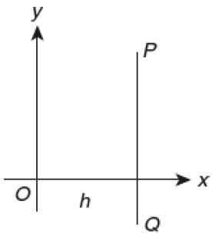
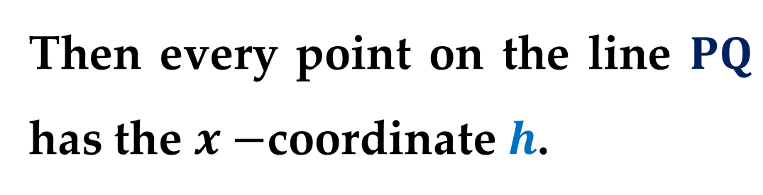
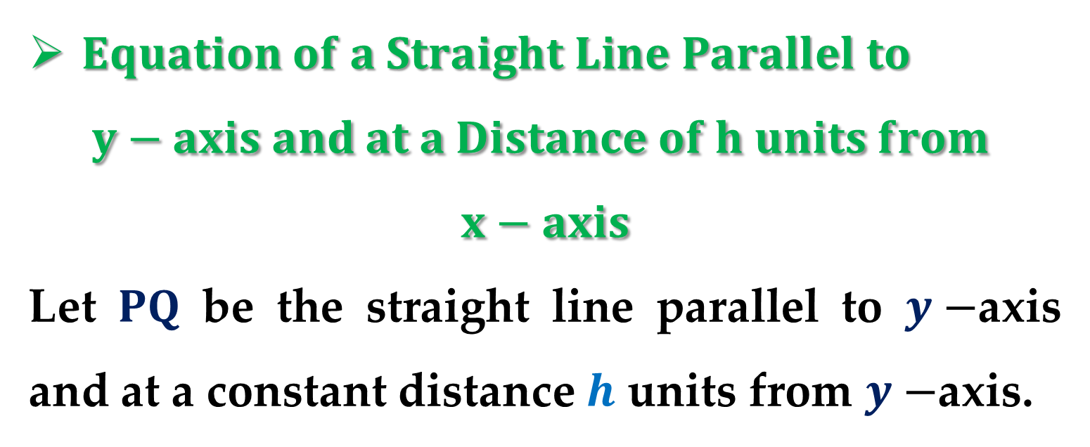
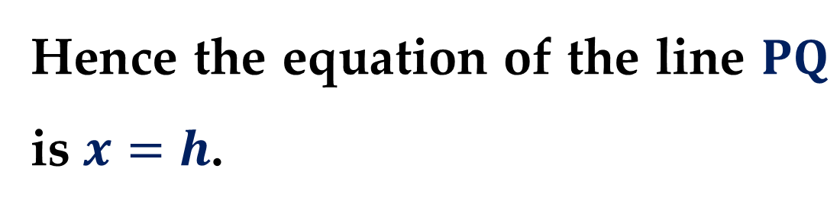
$Equation of a Straight Line Parallel to$
$$y−axis and at a Distance of h units from$$
$$x−axis$$
Let $PQ$ be the straight line parallel to $y−$axis and at a constant distance $h$ units from $y−$axis.
Then every point on the line $PQ$ has the $x−$coordinate $h$.
Hence the equation of the line $PQ$ is $x=h$.

Slide 11
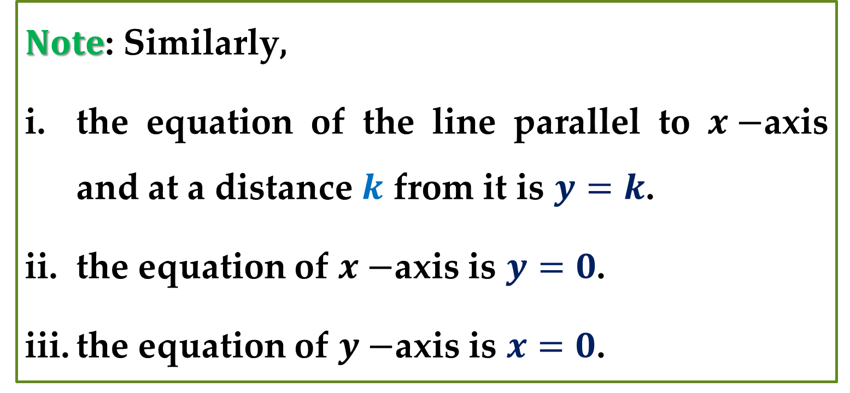
$Note$: Similarly,
the equation of the line parallel to $x−$axis and at a distance $k$ from it is $y=k$.
the equation of $x−$axis is $y=0$.
the equation of $y−$axis is $x=0$.

Slide 12
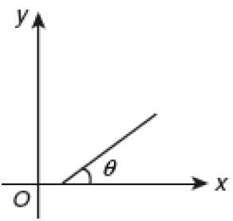
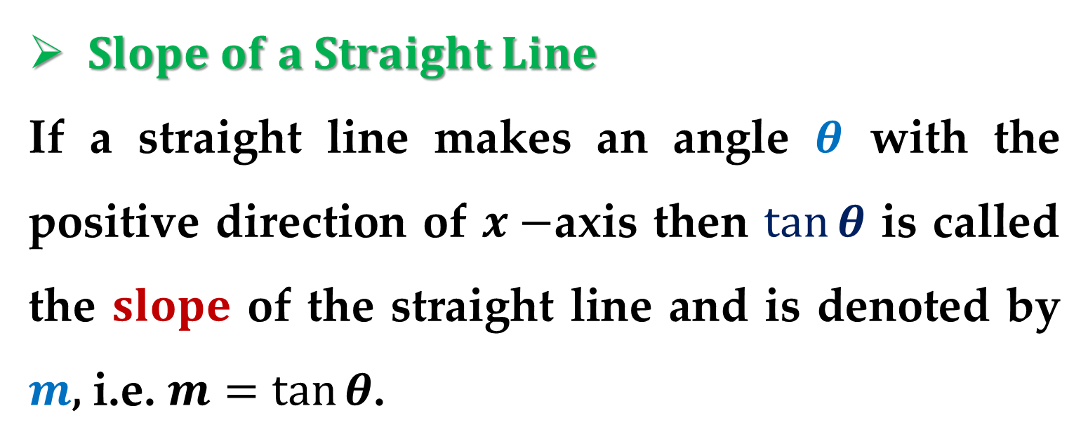
$Slope of a Straight Line$
If a straight line makes an angle $θ$ with the positive direction of $x−$axis then $tan⁡θ$ is called the $slope$ of the straight line and is denoted by $m$, i.e. $m=\tan{θ}$.
We can now determine the slope of a straight line in terms of coordinates of two points on the line.

Slide 13
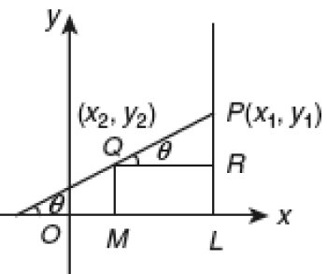
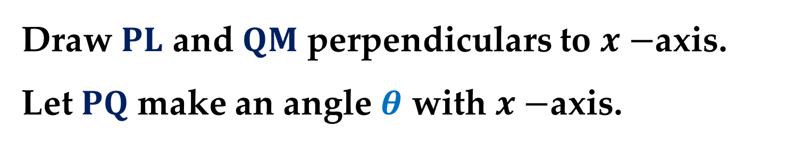
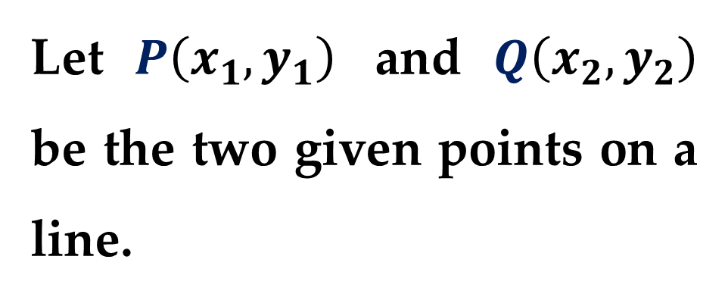
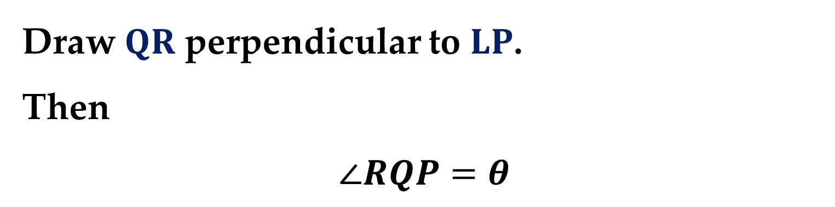
Let $P\left(x_{1}, y_{1}\right)$ and $Q\left(x_{2}, y_{2}\right)$ be the two given points on a line.
Draw $PL$ and $QM$ perpendiculars to $x−$axis.
Let $PQ$ make an angle $θ$ with $x−$axis.
Draw $QR$ perpendicular to $LP$.
Then
$$∠RQP=θ$$

Slide 14
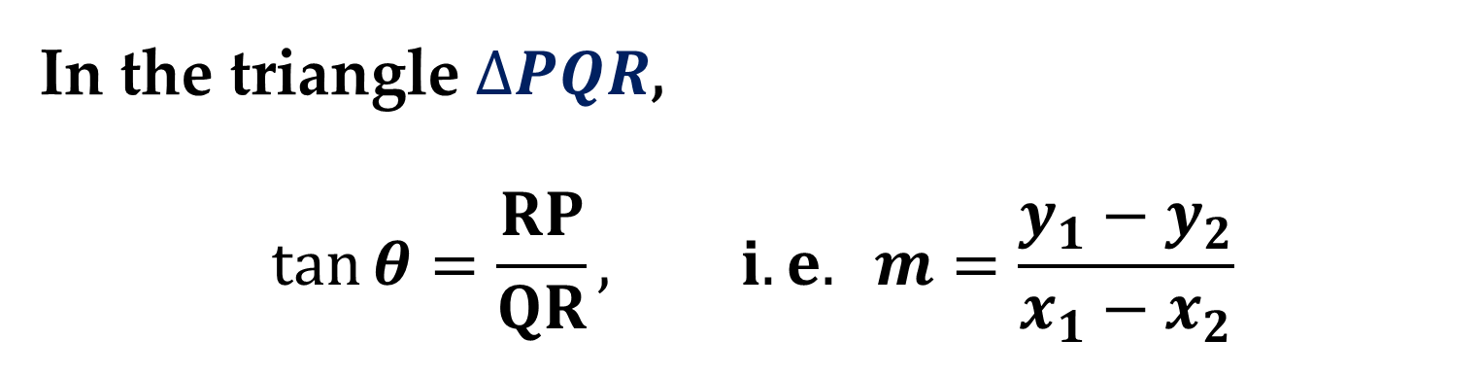
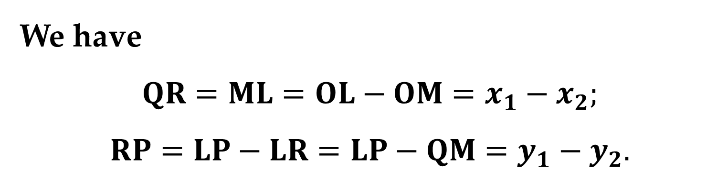
We have
$$QR=ML=OL−OM=x_{1}−x_{2};$$
$$RP=LP−LR=LP−QM=y_{1}−y_{2}.$$
In the triangle $ΔPQR$,
$$\tan{θ}=\frac{RP}{QR}, i.e. m=\frac{y_{1}−y_{2}}{x_{1}−x_{2}}$$
To calculate the slope of a straight line you can use any two distinct points on the line.

Slide 15
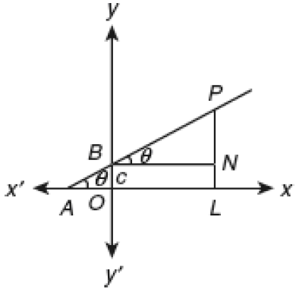
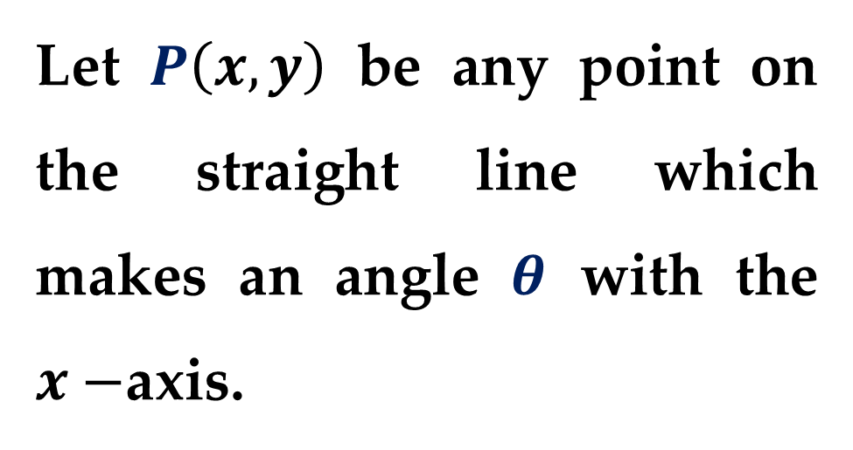
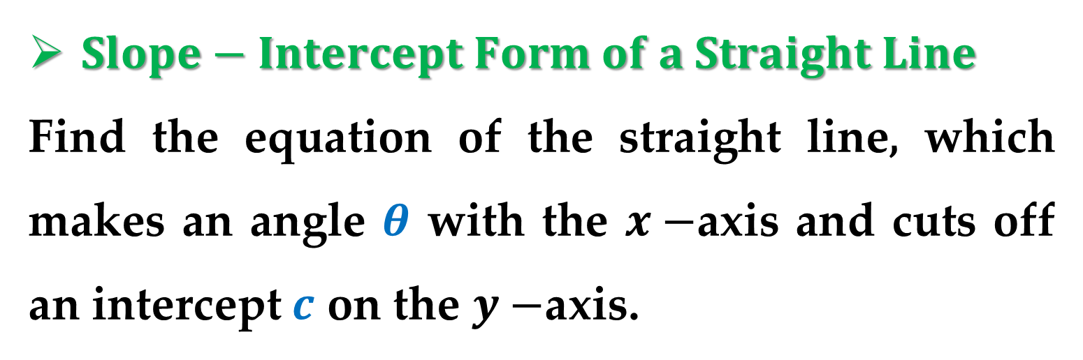
$Slope−Intercept Form of a Straight Line$
Find the equation of the straight line, which makes an angle $θ$ with the $x−$axis and cuts off an intercept $c$ on the $y−$axis.
Let $P\left(x, y\right)$ be any point on the straight line which makes an angle $θ$ with the $x−$axis.

Slide 16
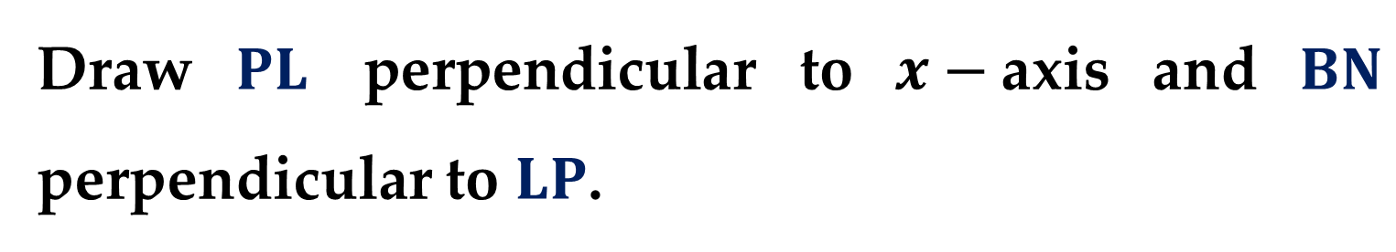
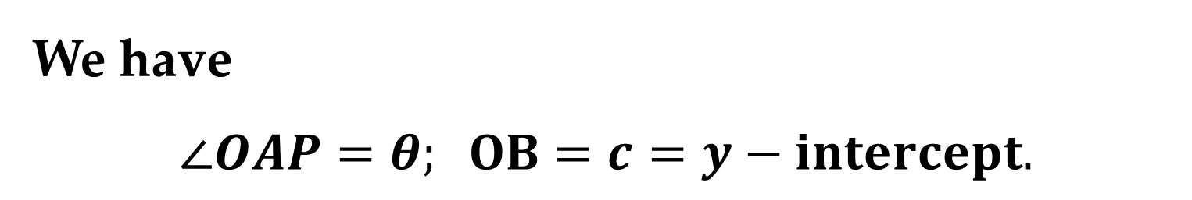
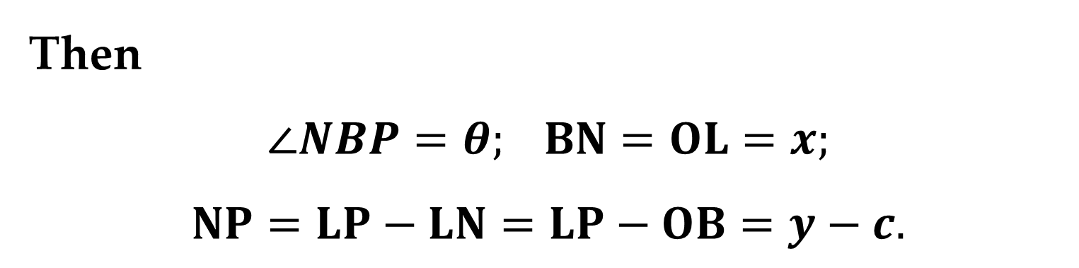
We have
$$∠OAP=θ; OB=c=y−intercept.$$
Draw $PL$ perpendicular to $x−$axis and $BN$ perpendicular to $LP$.
Then
$$∠NBP=θ; BN=OL=x;$$
$$NP=LP−LN=LP−OB=y−c.$$

Slide 17
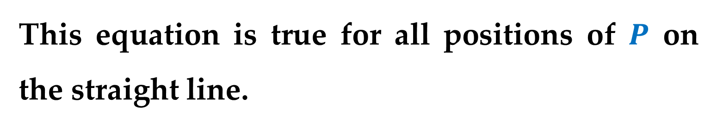
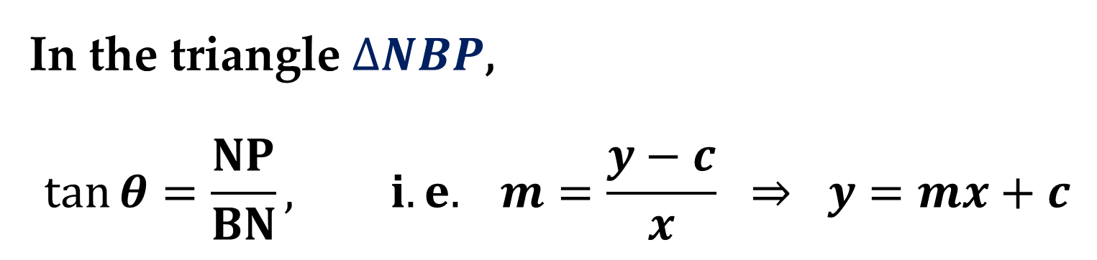
In the triangle $ΔNBP$,
$$\tan{θ}=\frac{NP}{BN}, i.e. m=\frac{y−c}{x} ⇒ y=mx+c$$
This equation is true for all positions of $P$ on the straight line.
Hence, this is the equation of the required line.

Slide 18
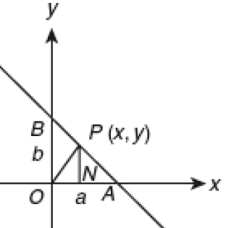
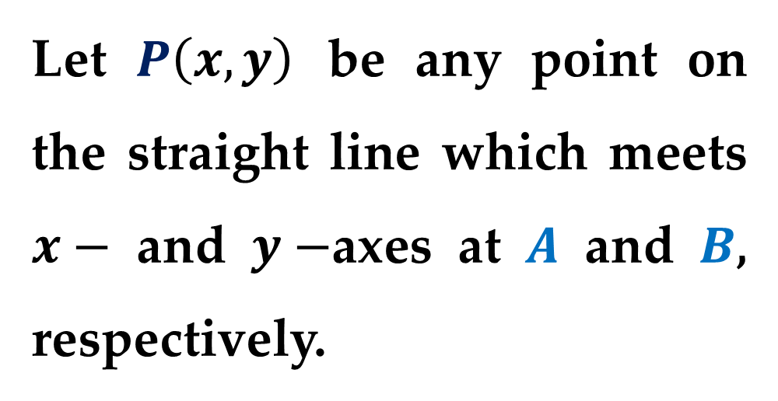
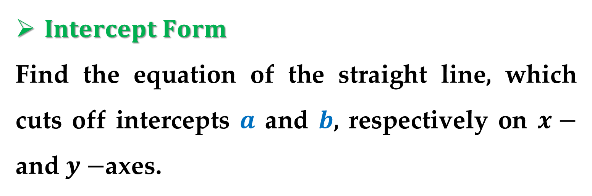
$Intercept Form$
Find the equation of the straight line, which cuts off intercepts $a$ and $b$, respectively on $x−$ and $y−$axes.
Let $P\left(x, y\right)$ be any point on the straight line which meets $x−$ and $y−$axes at $A$ and $B$, respectively.

Slide 19
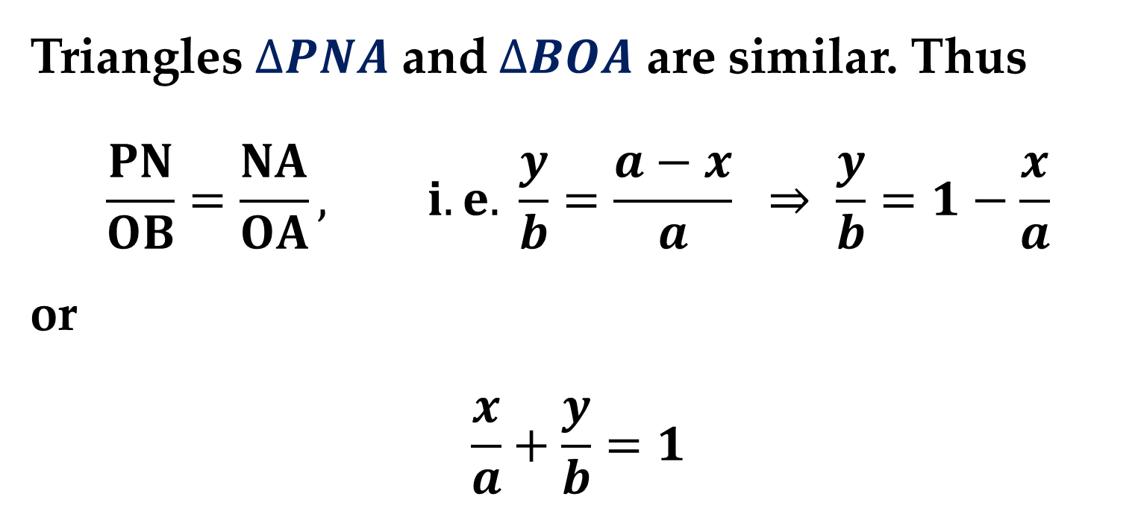
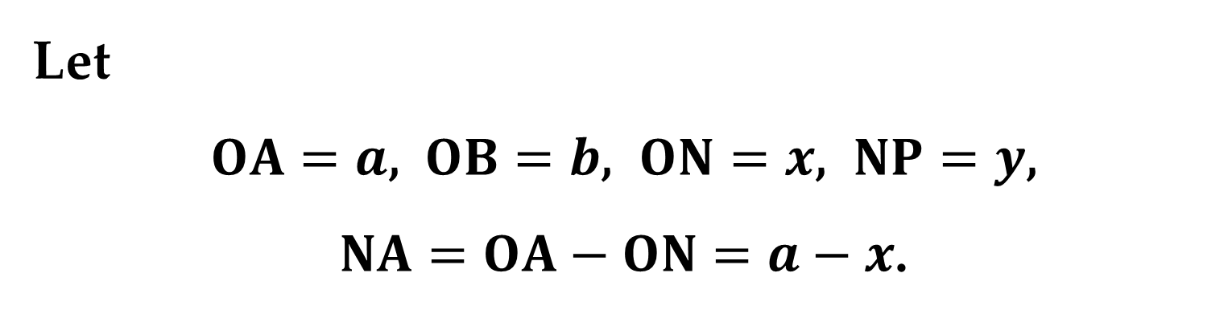
Let
$OA=a$, $OB=b$, $ON=x$, $NP=y$,
$NA=OA−ON=a−x$.
Triangles $ΔPNA$ and $ΔBOA$ are similar. Thus
$$\frac{PN}{OB}=\frac{NA}{OA}, i.e. \frac{y}{b}=\frac{a−x}{a} ⇒ \frac{y}{b}=1−\frac{x}{a}$$
or
$$\frac{x}{a}+\frac{y}{b}=1$$

Slide 20
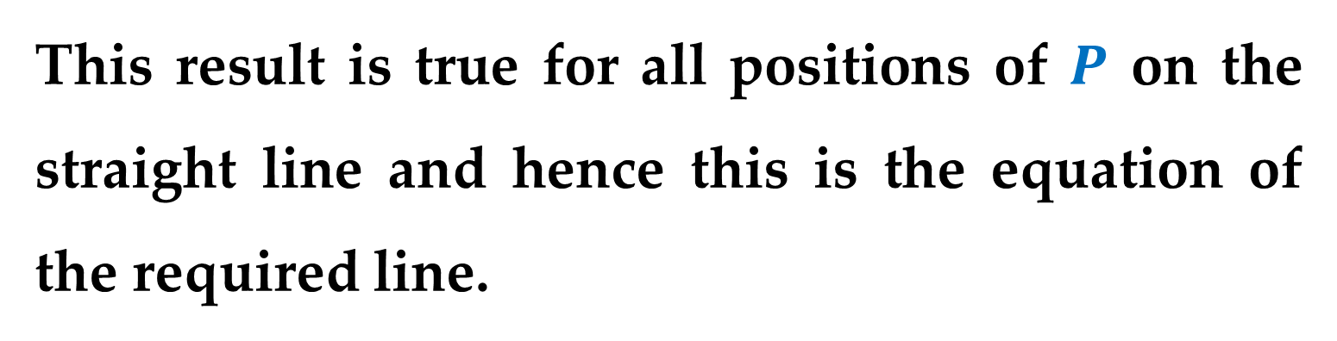
This result is true for all positions of $P$ on the straight line and hence this is the equation of the required line.

Slide 21
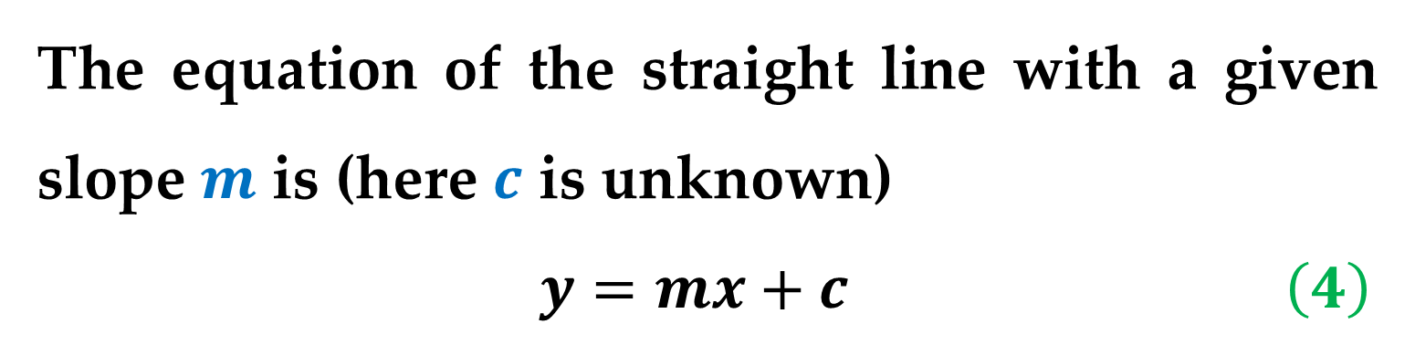
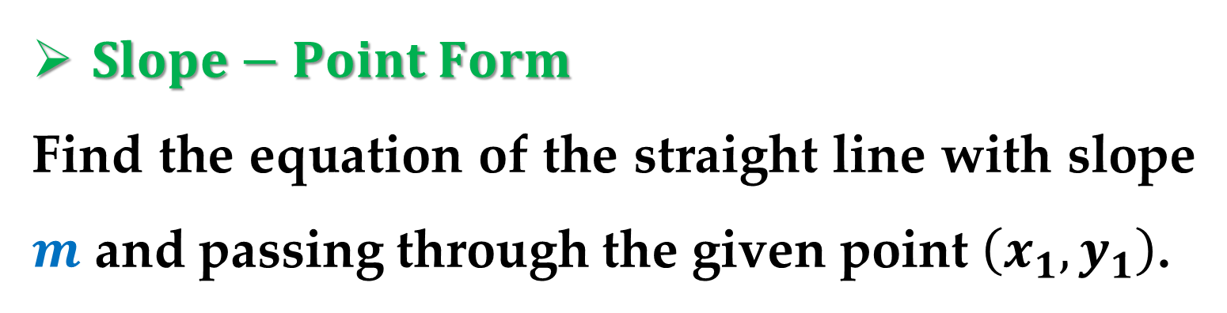
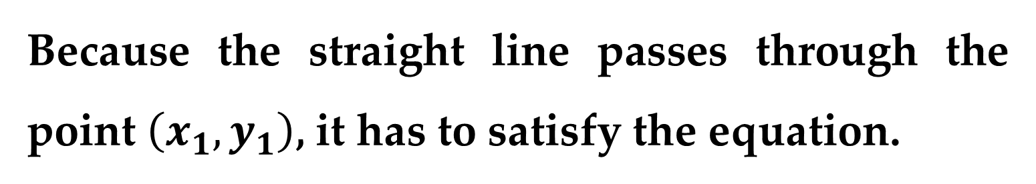
$Slope−Point Form$
Find the equation of the straight line with slope $m$ and passing through the given point $\left(x_{1}, y_{1}\right)$.
The equation of the straight line with a given slope $m$ is (here $c$ is unknown)
$y=mx+c$ $\left(4\right)$
Because the straight line passes through the point $\left(x_{1}, y_{1}\right)$, it has to satisfy the equation.

Slide 22
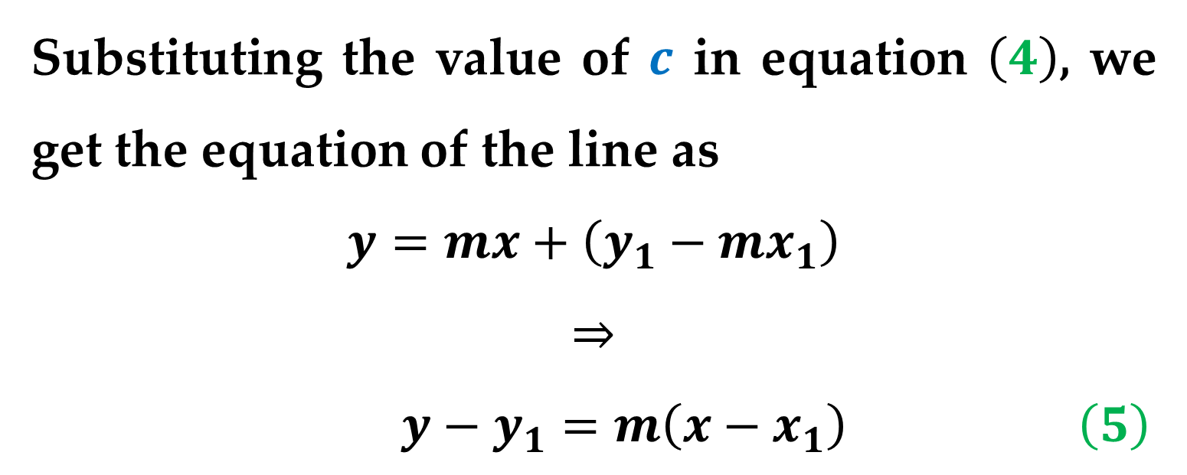
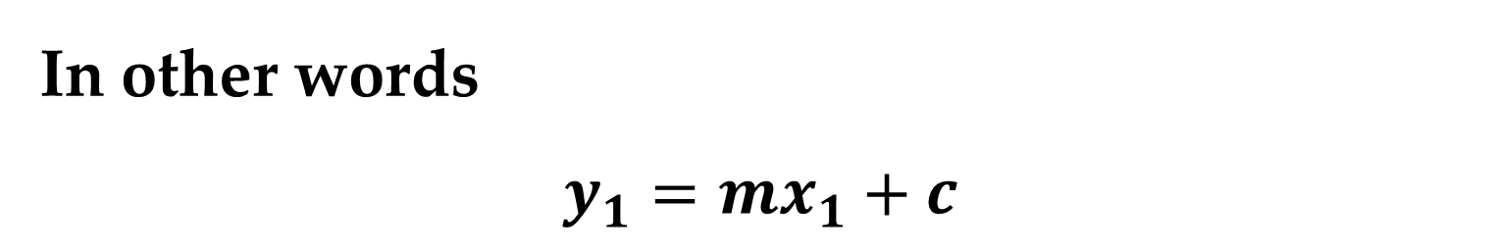
In other words
$$y_{1}=mx_{1}+c$$
Substituting the value of $c$ in equation $\left(4\right)$, we get the equation of the line as
$$y=mx+\left(y_{1}−mx_{1}\right)$$
$$⇒$$
$y−y_{1}=m\left(x−x_{1}\right)$ $\left(5\right)$

Slide 23
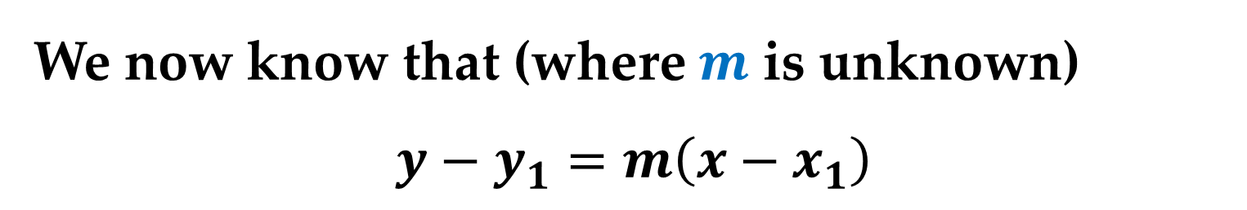
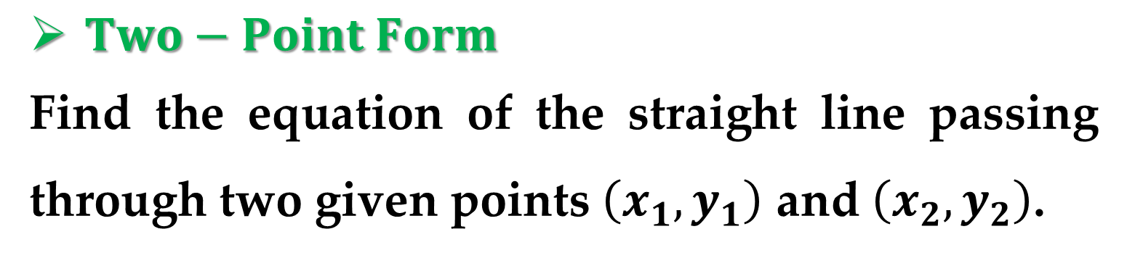

$Two−Point Form$
Find the equation of the straight line passing through two given points $\left(x_{1}, y_{1}\right)$ and $\left(x_{2}, y_{2}\right)$.
We now know that (where $m$ is unknown)
$$y−y_{1}=m\left(x−x_{1}\right)$$
The slope of the straight line passing through the points $\left(x_{1}, y_{1}\right)$ and $\left(x_{2}, y_{2}\right)$ is
$$m=\frac{y_{1}−y_{2}}{x_{1}−x_{2}} \left(6\right)$$

Slide 24

By substituting equation $\left(6\right)$ in equation $\left(5\right)$, we get the required straight line
$$y−y_{1}=\frac{y_{1}−y_{2}}{x_{1}−x_{2}}\left(x−x_{1}\right)$$
that is
$$\frac{y−y_{1}}{y_{1}−y_{2}}=\frac{x−x_{1}}{x_{1}−x_{2}}$$

Slide 25




$Normal Form$
Find the equation of a straight line in terms of the perpendicular $p$ from the origin to the line and the angle $α$ that the perpendicular line makes with the $x−$axis.
Draw $OL⊥AB$. Let $OL=p$ and $∠AOL=α$.
It is evident that $∠OBA=α$.

Slide 26



Then
$$\frac{OA}{OL}=\sec{α} ⇒ OA=OL \sec{α}=p \sec{α}$$
$$\frac{OB}{OL}=\csc{α} ⇒ OB=OL \csc{α}=p \csc{α}$$
Therefore, the equation of the straight line $AB$ is
$$\frac{x}{p \sec{α}}+\frac{y}{p \csc{α}}=1 ⇒ x\cos{α}+y\sin{α}=p.$$

Slide 27




$Parametric Form and Distance Form$
Let a straight line make an angle $θ$ with $x−$axis and $A\left(x_{1}, y_{1}\right)$ be a point on the line.
Draw $AL$ and $PM$ perpendicular to $x−$axis, as well as $AQ$ perpendicular to $PM$.
Then
$$∠PAQ=θ$$
Let $AP=r$.

Slide 28


We have
$$AQ=LM=OM−OL=x−x_{1};$$
$$QP=MP−MQ=MP−LA=y−y_{1}.$$
In the triangle $ΔPAQ$, we have
$$x−x_{1}=r\cos{θ}; y−y_{1}=r\sin{θ} ⇒$$
$$\frac{x−x_{1}}{\cos{θ}}=\frac{y−y_{1}}{\sin{θ}}=r$$
These are the parametric equations of the given line.

Slide 29

$Note$: Any point on the line is defined by
$$x=x_{1}+r\cos{θ}; y=y_{1}+r\sin{θ}.$$
$r$ is the distance of any point on the line from the given point $A\left(x_{1},y_{1}\right)$.

Slide 30




$Perpendicular Distance on a Straight Line$
Find the perpendicular distance from a given point to the line defined by $ax+by+c =0$.
Let $R\left(x_{1}, y_{1}\right)$ be a given point.
Through $R$ draw the line $PQ$ parallel to $AB$.
Draw $OS$ perpendicular to $AB$ meeting $PQ$ at the point $T$.
Let $OS=p$ and $OT=p_{1}$.

Slide 31



Let also $∠AOS=α$. Then the equation of $AB$ is
$x\cos{α}+y\sin{α}=p$ $\left(7\right)$
This is the same as
$ax+by=−c$ $\left(8\right)$
Equations $\left(7\right)$ and $\left(8\right)$ represent the same line and, although the corresponding coefficients may not equal each other, the quotients of the corresponding coefficients are definitely equal to each other.

Slide 32


Consider, for example, the two equations:
$$3x+2y=1 and 6x+4y=2$$
These two equations represent the same line on the plane, although the corresponding coefficients are different.
But we note the relations between the corresponding coefficients:
$$\frac{3}{6}=\frac{2}{4}=\frac{1}{2}=0.5$$

Slide 33


With relation to $\left(7\right)$ and $\left(8\right)$, we obtain:
$$\frac{\cos{α}}{a}=\frac{\sin{α}}{b}=\frac{p}{−c}=±\frac{\sqrt{\cos^{2}{α}+\sin^{2}{α}}}{\sqrt{a^{2}+b^{2}}}$$
Indeed, for the previous example, we have
$\sqrt{3^{2}+2^{2}}=\sqrt{13}$ – the first line;
$\sqrt{6^{2}+4^{2}}=\sqrt{52}$ – the second line;
and their relation is ${\sqrt{13}}/{\sqrt{52}}=\sqrt{1/4}=0.5$.

Slide 34


Therefore
$$\cos{α}=±\frac{a}{\sqrt{a^{2}+b^{2}}}; \sin{α}=±\frac{b}{\sqrt{a^{2}+b^{2}}};$$
$$p=∓\frac{c}{\sqrt{a^{2}+b^{2}}}$$
The equation of the line $PQ$ is
$$x cos α + y sin α = p_{1}$$

Slide 35


Since the point $R\left(x_{1}, y_{1}\right)$ lies on the line, it must satisfy the equation:
$$x_{1} cos α + y_{1} sin α = p_{1}$$
Then the length of the perpendicular line from $R$ to $AB$ is
$$p−p_{1}=p−x_{1} cos α−y_{1} sin α=$$
$$=∓\frac{c}{\sqrt{a^{2}+b^{2}}}∓\frac{ax_{1}}{\sqrt{a^{2}+b^{2}}}∓\frac{by_{1}}{\sqrt{a^{2}+b^{2}}}=…$$

Slide 36


$$…=∓\frac{ax_{1}+by_{1}+c}{\sqrt{a^{2}+b^{2}}}=\left|\frac{ax_{1}+by_{1}+c}{\sqrt{a^{2}+b^{2}}}\right|$$
$Note$: The perpendicular distance from the origin to the line $ax+by+c=0$ is
$$\frac{\left|c\right|}{\sqrt{a^{2}+b^{2}}}$$

Slide 37



$Intersection of Two Straight Lines$
Let the two intersecting straight lines be
$a_{1}x+b_{1}y+c_{1}=0$ and $a_{2}x+b_{2}y+c_{2}=0$
Let the straight lines intersect at the point $(x^{∗}, y^{∗})$.
Then $(x^{∗}, y^{∗})$ lies on both the lines and hence satisfy these equations, i.e.
$a_{1}x^{∗}+b_{1}y^{∗}+c_{1}=0$ and $a_{2}x^{∗}+b_{2}y^{∗}+c_{2}=0$

Slide 38


Solving the equations (using, for example, the Cramer’s rule), we obtain:
$$\frac{x^{∗}}{b_{1}c_{2}−b_{2}c_{1}}=\frac{y^{∗}}{c_{1}a_{2}−c_{2}a_{1}}=\frac{1}{a_{1}b_{2}−a_{2}b_{1}}$$
Therefore, the point of intersection is
$$\left(\frac{b_{1}c_{2}−b_{2}c_{1}}{a_{1}b_{2}−a_{2}b_{1}};\frac{a_{2}c_{1}−a_{1}c_{2}}{a_{1}b_{2}−a_{2}b_{1}}\right)$$

Slide 39



$Problem$: Find the ratio at which the line $ax+by+c=0$ divides the line joining the points $\left(x_{1}, y_{1}\right)$ and $\left(x_{2}, y_{2}\right)$.
Let the line $ax+by+c=0$ divide the line joining the points $P\left(x_{1}, y_{1}\right)$ and $Q\left(x_{2}, y_{2}\right)$ in the ratio $λ:1$.
Then the coordinates of the point of division $R$
$$\left(\frac{x_{1}+λx_{2}}{λ+1};\frac{y_{1}+λy_{2}}{λ+1}\right)$$

Slide 40



This point lies on the line $ax+by+c=0$, thus
$$a\left(\frac{x_{1}+λx_{2}}{λ+1}\right)+b\left(\frac{y_{1}+λy_{2}}{λ+1}\right)+c=0$$
From this it follows that
$$a\left(x_{1}+λx_{2}\right)+b\left(y_{1}+λy_{2}\right)+c\left(λ+1\right)=0 ⇒$$
$$\left[ax_{1}+by_{1}+c\right]+λ\left[ax_{2}+by_{2}+c\right]=0$$
Therefore
$$λ=−\frac{ax_{1}+by_{1}+c}{ax_{2}+by_{2}+c}$$

Slide 41

$Note$:
If $λ$ is positive, then the points $\left(x_{1}, y_{1}\right)$ and $\left(x_{2}, y_{2}\right)$ lie on the opposite sides of the line $ax+by+c=0$.
If $λ$ is negative, then the points $\left(x_{1}, y_{1}\right)$ and $\left(x_{2}, y_{2}\right)$ lie on the same side of the line $ax+by+c=0$.

Slide 42

$Note$: $\left(continued\right)$ In other words,
if the expressions $ax_{1}+by_{1}+c$ and $ax_{2}+by_{2}+c$ are of opposite signs then the points $\left(x_{1}, y_{1}\right)$ and $\left(x_{2}, y_{2}\right)$ lie on the opposite sides of the line $ax+by+c=0$;
if they are of the same sign then the points $\left(x_{1}, y_{1}\right)$ and $\left(x_{2}, y_{2}\right)$ lie on the same side of the line $ax+by+c=0$.

Slide 43



$Problem$: Find the equation of a straight line passing through the intersection of the lines
$a_{1}x+b_{1}y+c_{1}=0$ and $a_{2}x+b_{2}y+c_{2}=0$
Consider the equation
$a_{1}x+b_{1}y+c_{1}+λ\left(a_{2}x+b_{2}y+c_{2}\right)=0$ $\left(9\right)$
This is a linear equation in $x$ and $y$ and hence represents a straight line.

Slide 44



Let $\left(x^{∗},y^{∗}\right)$ be the point of intersection of lines $a_{1}x+b_{1}y+c_{1}=0$ and $a_{2}x+b_{2}y+c_{2}=0$.
Then $\left(x^{∗},y^{∗}\right)$ has to satisfy the two equations:
$a_{1}x^{∗}+b_{1}y^{∗}+c_{1}=0$ $\left(10\right)$
$a_{2}x^{∗}+b_{2}y^{∗}+c_{2}=0$ $\left(11\right)$
On multiplying equation $\left(11\right)$ by $λ$ and adding with equation $\left(10\right)$, we obtain
$$\left[a_{1}x^{∗}+b_{1}y^{∗}+c_{1}\right]+λ\left[a_{2}x^{∗}+b_{2}y^{∗}+c_{2}\right]=0$$

Slide 45


This equation shows that the point $\left(x^{∗},y^{∗}\right)$ satisfies equation $\left(9\right)$.
Hence the point $\left(x^{∗},y^{∗}\right)$ lies on the straight line given by the equation $\left(9\right)$, which is a line passing through the intersection of the lines
$a_{1}x+b_{1}y+c_{1}=0$ and $a_{2}x+b_{2}y+c_{2}=0$

Slide 46


$Concurrent Straight Lines$
Consider three straight lines given by:
$a_{1}x+b_{1}y+c_{1}=0$ $\left(12\right)$
$a_{2}x+b_{2}y+c_{2}=0$ $\left(13\right)$
$a_{3}x+b_{3}y+c_{3}=0$ $\left(14\right)$
The point of intersection of the lines given by equations $\left(12\right)$ and $\left(13\right)$ is
$$\left(\frac{b_{1}c_{2}−b_{2}c_{1}}{a_{1}b_{2}−a_{2}b_{1}};\frac{a_{2}c_{1}−a_{1}c_{2}}{a_{1}b_{2}−a_{2}b_{1}}\right)$$

Slide 47



If the three given lines are concurrent, the above point should lie on the straight line given by equation $\left(14\right)$.
Then
$$a_{3}\left(\frac{b_{1}c_{2}−b_{2}c_{1}}{a_{1}b_{2}−a_{2}b_{1}}\right)+b_{3}\left(\frac{a_{2}c_{1}−a_{1}c_{2}}{a_{1}b_{2}−a_{2}b_{1}}\right)+c_{3}=0$$
This results in
$$a_{3}\left(b_{1}c_{2}−b_{2}c_{1}\right)+b_{3}\left(a_{2}c_{1}−a_{1}c_{2}\right)+$$
$$c_{3}\left(a_{1}b_{2}−a_{2}b_{1}\right)=0$$

Slide 48

This is the required condition for the three given lines to be concurrent.
The above condition can be expressed in determinant form as follows:
$$\left|\begin{matrix}a_{1} & b_{1} & c_{1} \\ a_{2} & b_{2} & c_{2} \\ a_{3} & b_{3} & c_{3}\end{matrix}\right|=0$$

Slide 49


$Problem$: If $l$, $m$, and $n$ are constants such that
$$l\left(a_{1}x+b_{1}y+c_{1}\right)+m\left(a_{2}x+b_{2}y+c_{2}\right)+$$
$$+n(a_{3}x+b_{3}y+c_{3})$$
vanishes identically, then prove that the lines $a_{1}x+b_{1}y+c_{1}=0,$ $a_{2}x+b_{2}y+c_{2}=0,$ and $a_{3}x+b_{3}y+c_{3}=0$ are concurrent.
Let the lines $a_{1}x+b_{1}y+c_{1}=0$ and $a_{2}x+b_{2}y+c_{2}=0$ meet at the point $\left(x^{∗}, y^{∗}\right)$.

Slide 50



Then
$a_{1}x^{∗}+b_{1}y^{∗}+c_{1}=0$ $\left(15\right)$
$a_{2}x^{∗}+b_{2}y^{∗}+c_{2}=0$ $\left(16\right)$
For all values of $x$ and $y$ we have
$$l\left(a_{1}x+b_{1}y+c_{1}\right)+m\left(a_{2}x+b_{2}y+c_{2}\right)+$$
$$+ n\left(a_{3}x+b_{3}y+c_{3}\right)=0$$
Then the last equality should be true for the point $\left(x^{∗}, y^{∗}\right)$ as well.

Slide 51



That is
$$l\left(a_{1}x^{∗}+b_{1}y^{∗}+c_{1}\right)+m\left(a_{2}x^{∗}+b_{2}y^{∗}+c_{2}\right)+$$
$$+ n\left(a_{3}x^{∗}+b_{3}y^{∗}+c_{3}\right)=0$$
Using equations $\left(15\right)$ and $\left(16\right)$, from the last identity, we conclude that
$$a_{3}x^{∗}+b_{3}y^{∗}+c_{3}=0$$
That is, the point $\left(x^{∗}, y^{∗}\right)$ lies on the line
$$a_{3}x+b_{3}y+c_{3}=0$$

Slide 52

Therefore, the lines $a_{1}x+b_{1}y+c_{1}=0,$ $a_{2}x+b_{2}y+c_{2}=0,$ and $a_{3}x+b_{3}y+c_{3}=0$ are concurrent at $\left(x^{∗}, y^{∗}\right)$.

Slide 53




$Angle Between Two Straight Lines$
Let $θ$ be the angle between two straight lines, whose slopes are $m_{1}$ and $m_{2}$.
Let the two lines with slopes $m_{1}$ and $m_{2}$ make angles $θ_{1}$ and $θ_{2}$ with $x−$axis.
Then
$$m_{1}=tan⁡θ_{1}$$
$$m_{2}=tan⁡θ_{2}$$

Slide 54


We have $θ=θ_{1}−θ_{2}$, and, therefore
$$\tan{θ}=\tan\left(θ_{1}−θ_{2}\right)=\frac{{\tan{θ}}_{1}−\tan{θ_{2}}}{1+{\tan{θ}}_{1}×\tan{θ_{2}}} ⇒$$
$$\tan{θ}=\frac{m_{1}−m_{2}}{1+m_{1}×m_{2}}$$
If the right-hand side of the last equation is positive, then $θ$ is an acute angle between the lines.

Slide 55


If right-hand side of the last equation is negative, then $θ$ is an obtuse angle between the lines.
From the last equation, it follows that
$$θ=\tan^{−1}\left(\frac{m_{1}−m_{2}}{1+m_{1}×m_{2}}\right)$$
Below we consider some special cases, which follow directly from the last equation.

Slide 56

$Note$: If the lines are parallel then $θ=0$ and
$$tan θ=tan⁡0=0$$
Consequently,
$$\frac{m_{1}−m_{2}}{1+m_{1}×m_{2}}=0 ⇒ m_{1}=m_{2}$$
Therefore, if two lines are parallel then their slopes are equal.

Slide 57

$Note$: If two lines are perpendicular then $θ=\frac{π}{2}$.
As a result
$$\tan{θ}=\tan{\frac{π}{2}}=±\frac{m_{1}−m_{2}}{1+m_{1}×m_{2}}=±∞ ⇒$$
$$1+m_{1}×m_{2}=0 ⇒ m_{1}×m_{2}=−1$$
Therefore, if the two lines are perpendicular then the product of their slopes is $−1$.

Slide 58



$Equations of Bisectors of the Angle$
$$Between Two Straight Lines$$
Let $AB$ and $CD$ be two straight lines intersecting at the point $P$.
Let these lines be
represented by equations
$a_{1}x+b_{1}y+c_{1}=0,$
$a_{2}x+b_{2}y+c_{2}=0,$
respectively.

Slide 59



Let $PR$ and $PR^{′}$ be the bisectors of the angles $∠APC$ and $∠CPB$, respectively.
Then the perpendicular distances from $R\left(x,y\right)$ (or $R^{′}$) to $AB$ and $CD$ are equal.
Therefore
$$\frac{a_{1}x+b_{1}y+c_{1} }{\sqrt{a_{1}^{2}+b_{1}^{2}}}=±\frac{a_{2}x+b_{2}y+c_{2} }{\sqrt{a_{2}^{2}+b_{2}^{2}}}$$

Slide 60


If $c_{1}$ and $c_{2}$ are positive, then the equation of the bisector containing the origin will given by
$$\frac{a_{1}x+b_{1}y+c_{1} }{\sqrt{a_{1}^{2}+b_{1}^{2}}}=+\frac{a_{2}x+b_{2}y+c_{2} }{\sqrt{a_{2}^{2}+b_{2}^{2}}} \left(18\right)$$
The equation of the bisector not containing the origin, when $c_{1}$ and $c_{2}$ are positive, is
$$\frac{a_{1}x+b_{1}y+c_{1} }{\sqrt{a_{1}^{2}+b_{1}^{2}}}=−\frac{a_{2}x+b_{2}y+c_{2} }{\sqrt{a_{2}^{2}+b_{2}^{2}}} \left(19\right)$$

Slide 61


If $c_{1}$ and $c_{2}$ are not positive, then the equations of lines should be written in such a way that both $c_{1}$ and $c_{2}$ become positive.
$Note$:
We can easily observe that the two bisectors are at the right angle.

Slide 62
Thank you for attention

